Slide 1

Project Proposal of A Mobile Plant Nursary
Let's Celebrate World Day of Energy Efficiency.

Slide 2

Table of contents
01
02
03
04
Background
Behind the scene of this project
Objective
The goal of this project
Features
You can describe the topic of the section here
Scope and benefits
Future possibility

Slide 3

Hello!
I am Md. Wahiduzzaman Nayem,
Student I’d : 201-35-2979,
Department of Software Engineering,
Daffodil Interantional University.

Slide 4


01
Background
The back story of this project

Slide 5

Here are three important back story
Traditional nursary
So, in traditional way, if we want to buy a plant, we have to go to the nursary and buy the plant.
Lack of options
But most of the times the local nursaries lacks various types of plants.
Time waste and uncertainity
When we don’t find the plant we want to buy, we have to search other nursary which takes a lot of time. On the other hand, even spending hours in searching we may not find the expected plants.

Slide 6
02
Objective
The goal of this project.

Slide 7

Here’s the four important objectives
Brings the plants to the people.
Convinience of buying live plants online from vans and trucks.
Varities of plans depending on your test.
Make the people understand the neccesity of plants and indoor-gardening.

Slide 8

03
Features
The features of this project

Slide 9
Reviewing features is a good idea
Login
Add to cart
Logout
Registration
Make an Order
Profile Create
Online payment
Profile Update
Confirmation
Choose Location
Choose plant/plants
Weather Preferences
See plant details
Plant Preferences
Plant pictures
Suggestions
Report/ Complain

Slide 10
04
Scopes and benefits
The features of this project

Slide 11
Here are the Scopes and the benifits
Easy purchase and idea about plants
This idea offers a unique and convenient way for people to purchase and learn about plants.
A potential business
It has the potential to grow into a successful business as people continue to embrace indoor gardening.
Environmental benefits
As people continue to embrace indoor gardening and the wellness benefits will eventually coming with it. Carbon emission will be reduced.

Slide 12




Prototypes

Slide 13
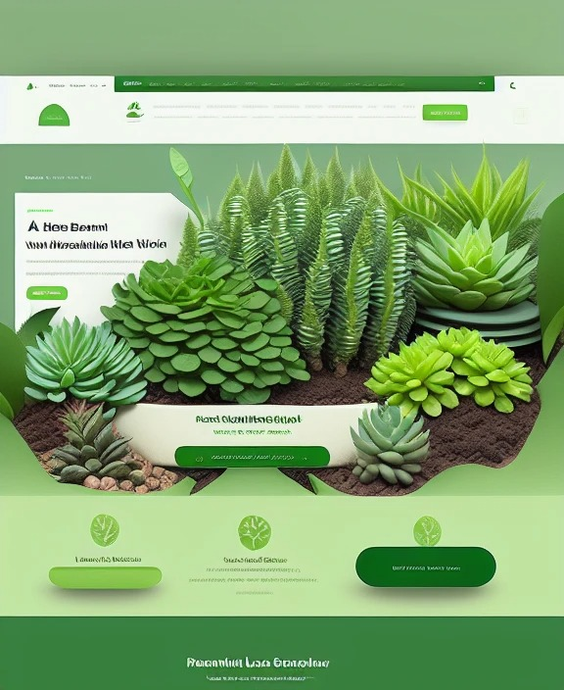

Slide 14
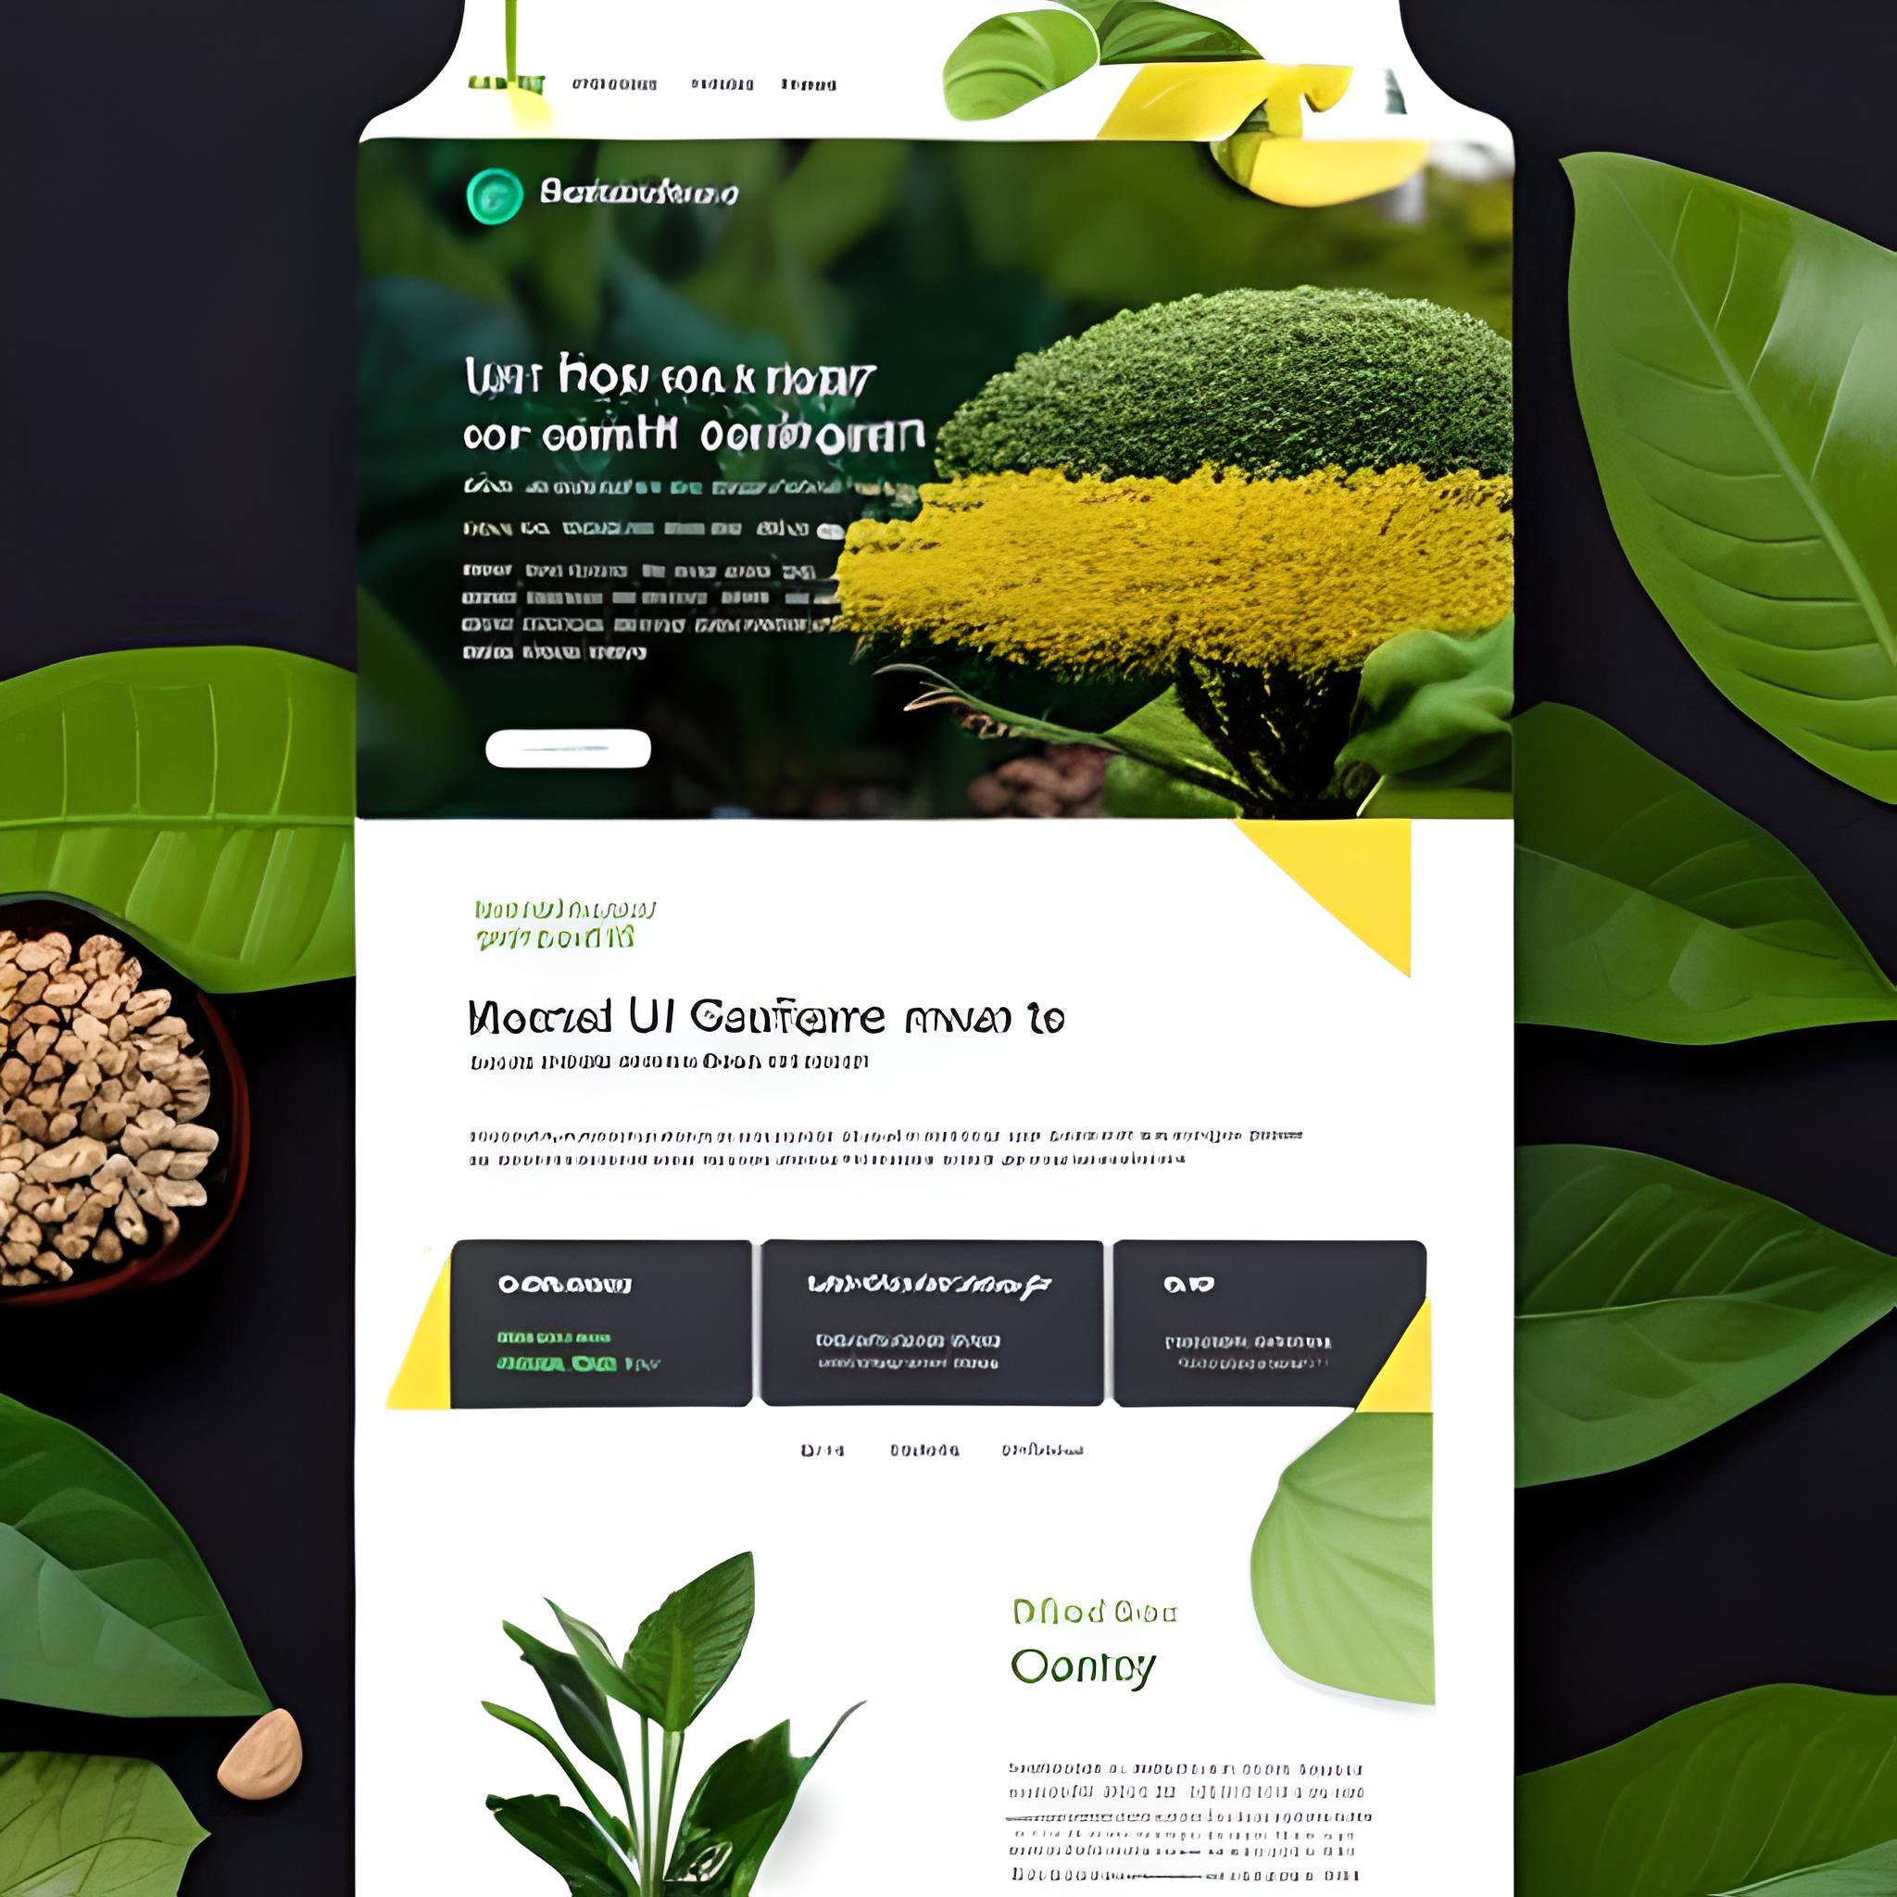

Slide 15
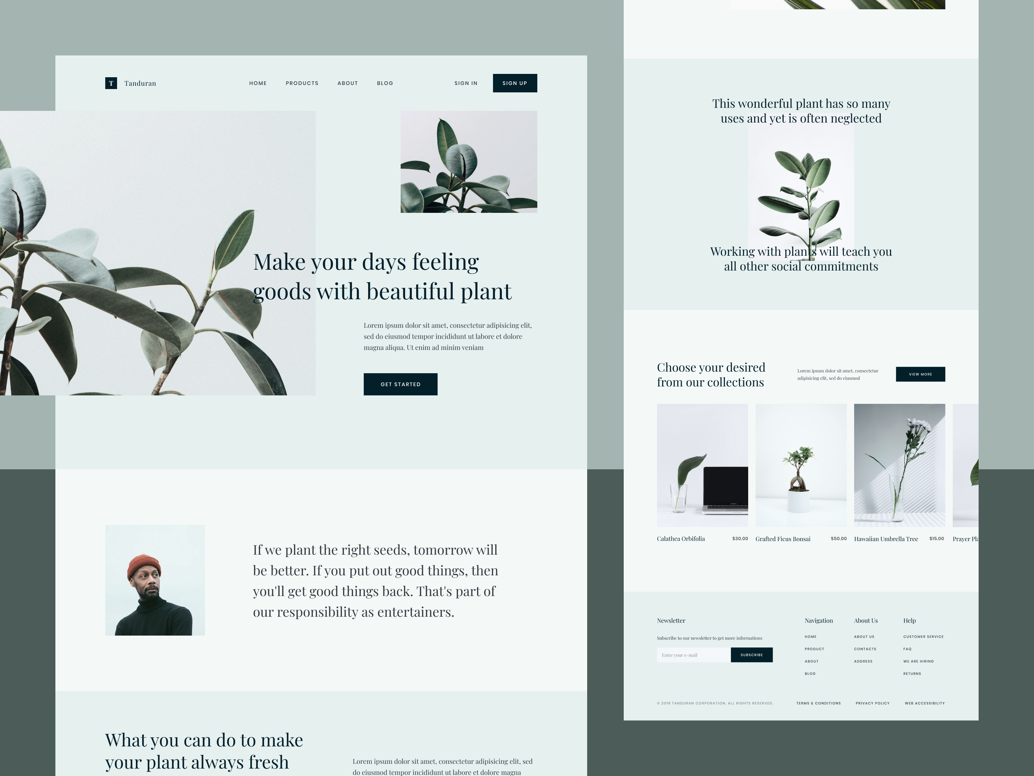

Slide 16


Slide 17
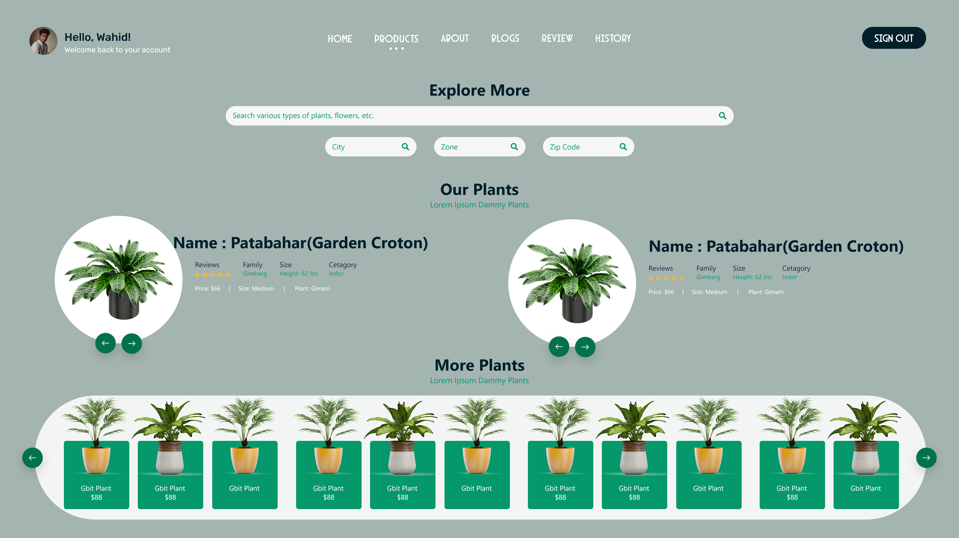

Slide 18
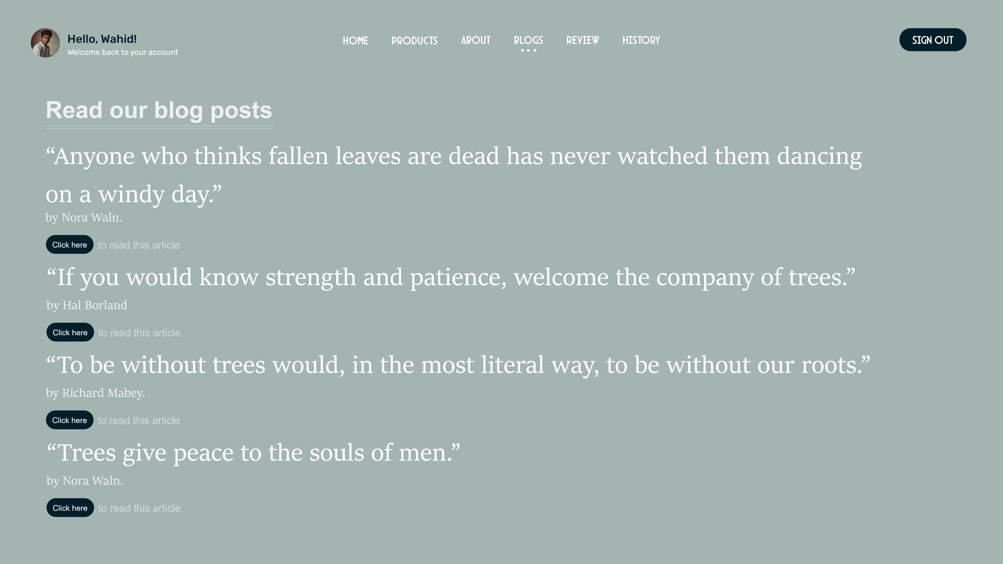

Slide 19
Awesome words

Slide 20
—Beth Ditto
“A beautiful plant is like having a friend around the house.”

Slide 21
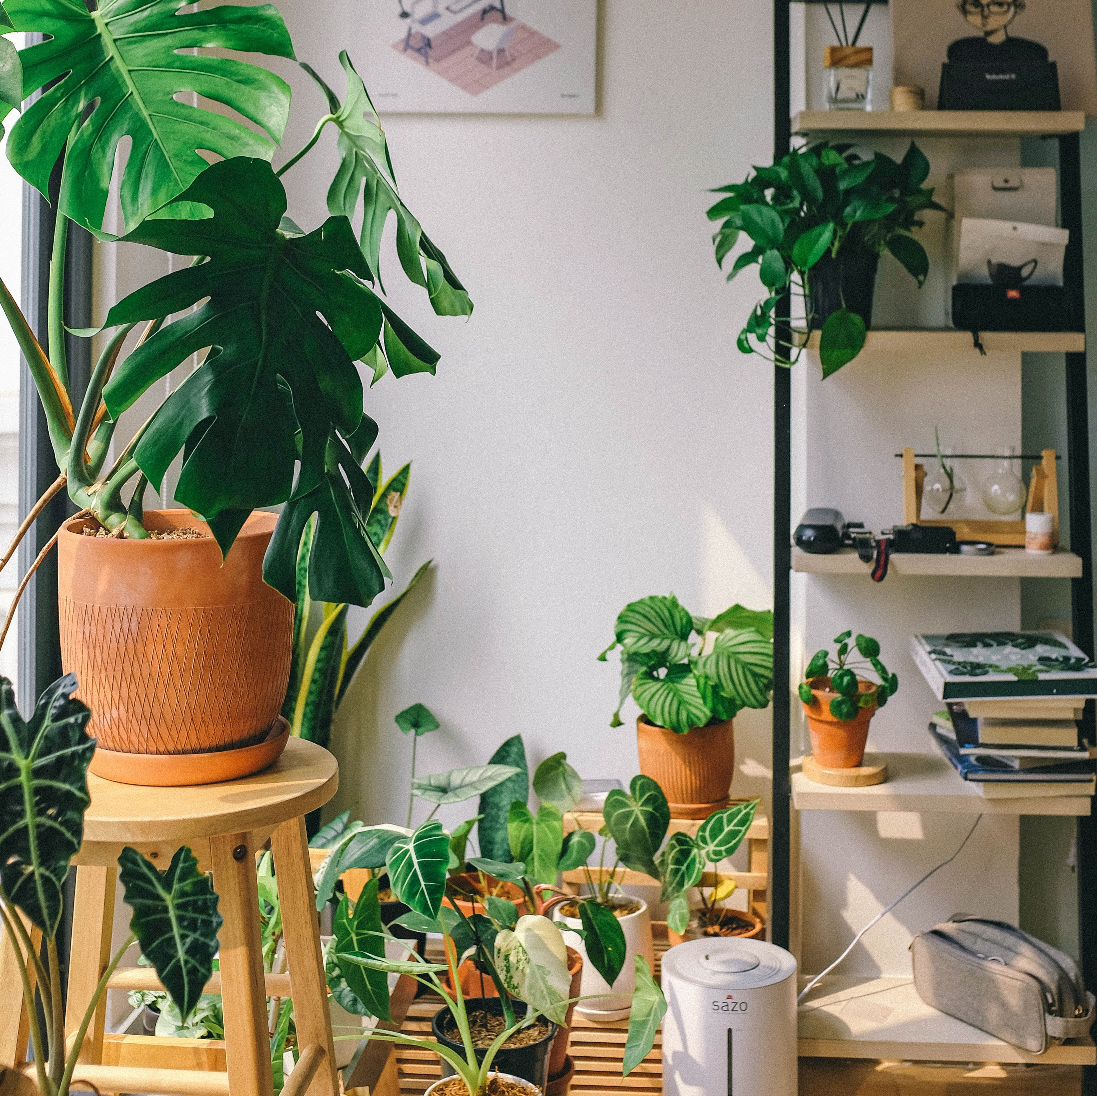
A picture always reinforces the concept

Slide 22
Thanks!
Do you have any questions?
muhammadwahiduzzaman2514@gmail.com
+880 17986 50646

